Slide 1
Reminders
Homework 9 or Project Milestone 1 are due Wednesday
I distributed data for HW9 for everyone who completed IRB training
Quiz on Chapters 15&16 is due tonight by 11:59pm.

Slide 2
Semantic Role Labeling
Jurafsky and Martin Chapter 20

Slide 3
Events and their Participants
A purchasing event and its participants can be described by a wide variety of surface forms.
XYZ corporation bought the stock.
They sold the stock to XYZ corporation.
The stock was bought by XYZ corporation.
The purchase of the stock by XYZ corporation...
The stock purchase by XYZ corporation...
Commonality: there was a purchase event, the participants were XYZ Corp and some amount of stock, and XYZ Corp was the buyer.
Semantic Role Labels give a shallow semantic representation of the event and its arguments.
Notes:
The event can be described by a verb (sold, bought) or a noun (purchase), and XYZ Corp can be the syntactic subject (of bought), the indirect object (of sold), or in a genitive or noun compound relation (with the noun purchase) despite having notionally the same role in all of them:

Slide 4
Semantic Roles
Last time we discussed neo-Davidsonian event representations.
Sasha broke the window
∃e, x, y Breaking(e) ∧ Breaker(e, Sasha) ∧BrokenThing(e,y)∧Window(y)
Pat opened the door.
∃e,x,y Opening(e)∧Opener(e,Pat) ∧OpenedThing(e,y)∧Door(y)
The semantic role of the subject of the break is Breaker
The semantic of the subject of the open is Opener
These deep roles are specific to each event.

Slide 5
Thematic Roles
Breakers and Openers have something in common. They are both volitional actors, usually animate, and they have a direct causal responsibility for their events.
Thematic roles are a way to capture this semantic commonality between these roles. In this case, both Breakers and Openers fill the thematic role of AGENT.
AGENT is the thematic role that represents an abstract idea such as volitional causation.
BrokenThing and OpenedThing, are both prototypically inanimate objects that are affected in some way by the action. The semantic role for participant most directly affected by an event is THEME ;

Slide 6
Thematic Roles
Thematic Role | Definition
AGENT | The volitional causer of an event
EXPERIENCER | The experiencer of an event
FORCE | The non-volitional causer of the event
THEME | The participant most directly affected by an event
RESULT | The end product of an event
CONTENT | The proposition or content of a propositional event
INSTRUMENT | An instrument used in an event
BENFICIARY | The beneficiary of an event
SOURCE | The origin of the object of a transfer event
GOAL | The destination of an object of a transfer event

Slide 7
Thematic Roles
Thematic Role | Definition
AGENT | The player kicked the ball.
EXPERIENCER | Dan has a cough and a fever.
FORCE | The coronavirus spread rapidly through the country
THEME | The wind blows debris from the street into our yard
RESULT | The city implemented a stay-at-home policy for non-essential personnel
CONTENT | Chris asked “You met Rebecca at a supermarket?”
INSTRUMENT | He poached catfish, stunning them with a shocking device…
BENFICIARY | Joe makes hotel reservations for his boss.
SOURCE | I flew in from Boston.
GOAL | I drove to Portland.

Slide 8
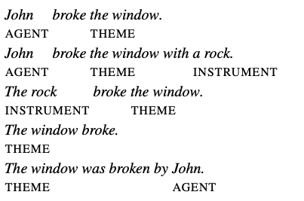
Verb Alternation
Semantic roles act as a shallow meaning representation that allow systems make simple inferences that aren’t possible from the surface string of words, or from the parse tree.
Arguments for verbs alternate in their positions, which makes pure surface analysis difficult.

Slide 9
Problems with Thematic Roles
Analysis of thematic roles should be useful for handling verb alternation. However, there is no single, standard set of thematic roles.
And it’s quite difficult to come up with a formal definition for things like AGENT, THEME, or INSTRUMENT.
For example, there are two kinds of INSTRUMENTS, intermediary instruments that can appear as subjects and enabling instruments that cannot:
The cook opened the jar with the new gadget. The new gadget opened the jar.
Shelly ate the sliced banana with a fork. *The fork ate the sliced banana.
Different theories of thematic roles treat these differently, which causes fragmentation across theories.

Slide 10
Generalized Semantic Roles
Instead of creating a more fine-grained inventory of Thematic Roles, research in NLP has shifted in the direction of coarser roles.
You may see terms like PROTO-AGENT and PROTO-PATIENT, which are generalized roles that express roughly agent-like and roughly patient-like meanings. These meanings are defined a set of heuristics.
A second direction that NLP goes in is to define semantic roles that are specific to each verb, or to a group of semantically related verbs or nouns.
Lexical resources that make use of this second direction are PropBank and FrameNet.

Slide 11
PropBank
PropBank, is a resource of Penn TreeBank sentences annotated with semantic roles. It was created by Martha Palmer at UPenn.
Because defining universal thematic roles is difficult, PropBank defines semantic roles for each verb sense.
Each verb has a specific set of roles, given by numbers: Arg0, Arg1, Arg2.
In general, Arg0 represents the PROTO-AGENT, and Arg1, the PROTO-PATIENT.
Martha Palmer

Slide 12
PropBank Frame File
Agree.01
Arg0: Agreer Arg1: Proposition Arg2: Other entity agreeing
Example 1: [Arg0 The group] agreed [Arg1 it wouldn’t make an offer]. Example 2: [ArgM-TMP Usually] [Arg0 Chris] agrees [Arg2 with Ellie] [Arg1 on everything].
Glosses to be read by humans

Slide 13
PropBank Frame File
Fall.01 Arg1: Logical subject, patient, thing falling Arg2: Extent / amount fallen Arg3: Start point Arg4: End point
Example 1: [Arg1 Sales] fell [Arg4 to $25 million] [Arg3 from $27 million].
Example 2: [Arg1 The average junk bond] fell [Arg2 by 4.2%].
Notes:
Note that there is no Arg0 role for fall, because the normal subject of fall is a PROTO-PATIENT.

Slide 14
PropBank Frame File
Increase.01 “go up incrementally” Arg0: Causer of increase Arg1: Thing increasing Arg2: Amount increased by Arg3: Start point Arg4: End point
Example 1: [Arg0 Big Fruit Co. ] increased [Arg1 the price of bananas]. Example 2: [Arg1 The price of bananas] was increased again [Arg0 by Big Fruit Co. ] Example 3: [Arg1 The price of bananas] increased [Arg2 5% ].
Notes:
A PropBank semantic role labeling would allow us to infer the commonality in the event structures of the following three examples, that is, that in each case Big Fruit Co. is the AGENT and the price of bananas is the THEME, despite the differing surface forms.

Slide 15
ArgMs
PropBank also has a number of non-numbered arguments called ArgMs, which represent modification meanings. These are stable across predicates, so aren’t listed with each frame file

Slide 16
FrameNet
In order to make semantic inferences about price increase events, we want to make the connection across many different verbs, not just the verb increase.
Example 1: [Arg1 The price of bananas] increased [Arg2 5% ]. Example 2: [Arg1 The price of bananas] rose [Arg2 5% ]. Example 3: There has been a [Arg2 5% ] rise in [Arg1 the price of bananas]
FrameNet is another Semantic Role Labeling project that attempts to address just these kinds of problems.
PropBank labels roles specific to an individual verb, and FrameNet labels roles are specific to a frame.

Slide 17
Frames
What is a frame? Consider the following set of words:
reservation, flight, travel, buy, price, cost, fare, rates, plane
They form coherent chunk of common-sense background information concerning air travel. The background knowledge that unites these words a frame.
The idea that groups of words are defined with respect to some back- ground information is widespread in AI and cognitive science. Similar to the notion of a script that we saw before.

Slide 18
Frame Elements
Frame: Change position on a scale

Slide 19
Lexical Units
Lexical Units that trigger the change position on a scale frame

Slide 21
Semantic Role Labeling
SRL is the task of automatically finding the semantic roles of each argument of each predicate in a sentence.
Most state-of-the-art approaches to SRL use supervised machine learning, with FrameNet and PropBank providing training and test sets and defining what counts as a predicate and what the roles are.

Slide 22
Primitive Decomposition of Predicates
One way of thinking about semantic is that they help us define the roles that arguments play in a decompositional way, based on finite lists of thematic roles.
Jim killed his philodendron. Jim did something to cause his philodendron to become not alive. KILL(x,y) ⇔ CAUSE(x, BECOME(NOT(ALIVE(y))))
John opened the door. ⇒ CAUSE(John, BECOME(OPEN(door)))
The door opened. ⇒ BECOME(OPEN(door))
The door is open. ⇒ OPEN(door)

Slide 23
Conceptual dependency primitives

Slide 24
Neo-Davidsonian Event with Primatives
The waiter brought Mary the check.
∃x,y Atrans(x)∧Actor(x,Waiter)∧Object(x,Check)∧To(x,Mary) ∧Ptrans(y)∧Actor(y,Waiter)∧Object(y,Check)∧To(y,Mary)

Slide 25
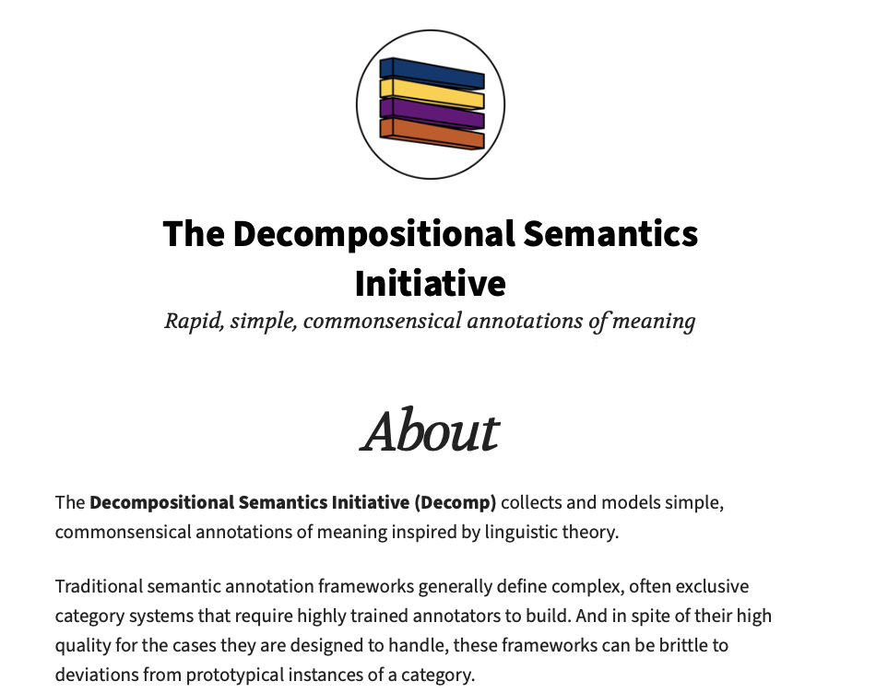
http://decomp.io

Slide 26
Conclusions
Semantic roles are abstract models of the role an argument plays in the event described by the predicate.
Thematic roles are a model of semantic roles based on a single finite list of roles.
Per-verb semantic role lists and proto-agent/proto-patient, are implemented in PropBank and FrameNet.
Semantic role labeling is the task of assigning semantic role labels to the constituents of a sentence.
Cool new research directions in finding event primatives.

